Slide 1
FASHION-FORWARD MALL
PERFORMANCE ANALYSIS
Ezeh Confidence Adaeze

Slide 2
TABLE OF CONTENT
Company Description
Problem Statement
Process
Dashboard
Insights
Recommendations

Slide 3
COMPANY DESCRIPTION
Fashion Forward Mall is a top shopping spot in the city, offering a variety of fashionable clothing, electronics, and lifestyle products. The mall is designed to give shoppers a great experience, with a focus on style and convenience. They have a wide range of stores, including popular Apparel and Electronics shops, known for their large selections and friendly service.
Fashion Forward Mall aims to attract a lot of visitors and turn them into loyal customers. With modern facilities, plus dining and entertainment options, it's a place where everyone can find something they love.
However, recent reviews show that their marketing and promotions might not be as effective as they’d like. They’re dedicated to improving their strategies, making their stores run smoothly, and engaging better with their customers to keep growing and ensuring everyone leaves happy.

Slide 4
PROBLEM STATEMENT
Fashion Forward Mall has observed fluctuating foot traffic and inconsistent sales patterns across its various stores. The mall management wants to understand the factors driving these fluctuations to enhance customer experience and optimize store performance. Key objectives include identifying peak shopping times, understanding customer preferences, and determining the impact of marketing campaigns and store promotions on sales.
Objective:
Analyze foot traffic patterns to identify peak shopping hours and days.
Determine customer preferences in terms of store types (e.g., apparel, electronics, food).
Evaluate the effectiveness of marketing campaigns and promotions on sales.
Provide actionable insights to improve customer experience and boost overall sales.

Slide 5
PROCESS
Data Collection
Data Description
Data Cleaning
Data Modelling
Data Analysis
Data Visualization
Insights
Recommendations

Slide 6
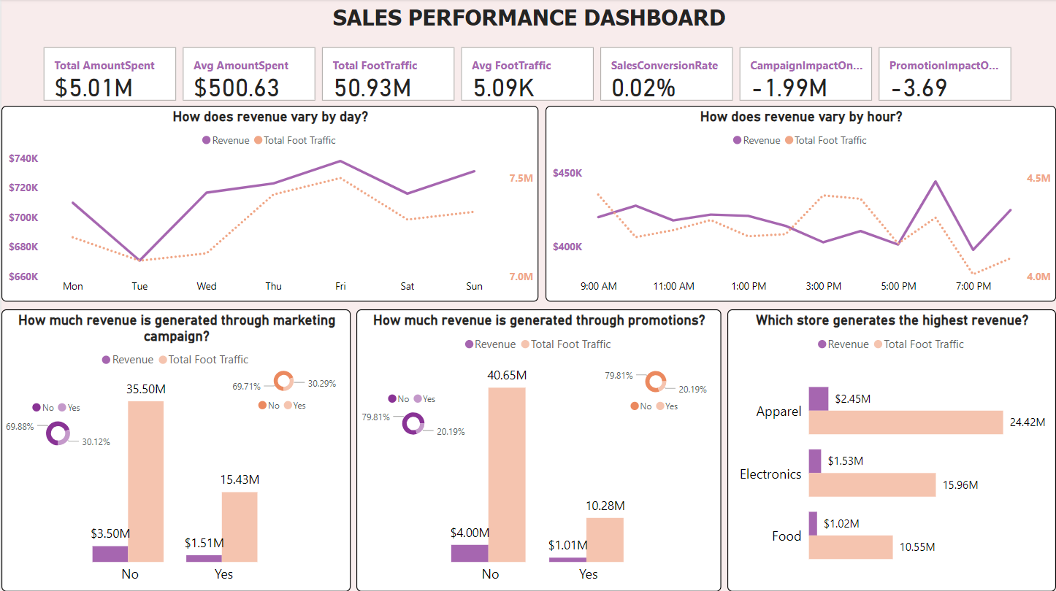
DASHBOARD (Overview)

Slide 7
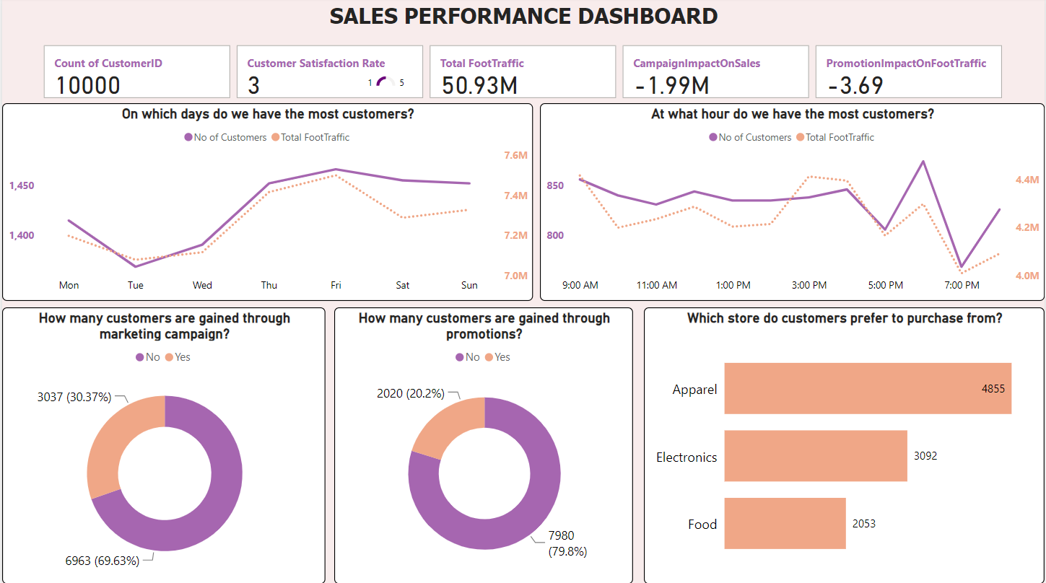
DASHBOARD (Customers)

Slide 8
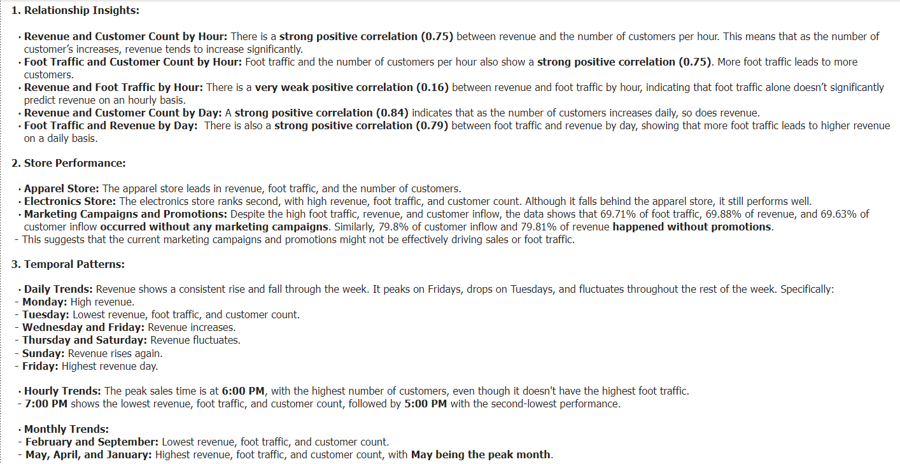
INSIGHTS

Slide 9
RECOMMENDATIONS
Reevaluate marketing and promotional strategies or explore alternative methods to boost their effectiveness.
Focus on optimizing operations and staffing for peak times (e.g., 6:00 PM) and days (e.g., Friday). Conversely, develop strategies to boost performance on lower-performing days like Tuesday.
Since the apparel store outperforms others, understanding and leveraging its successful strategies could be beneficial. Replicate its foot traffic-driving techniques across other stores.
The strong daily correlation suggests that increasing foot traffic remains crucial. Enhance strategies to attract more customers throughout the day and week to maximize revenue.
Leverage high-performing months (e.g., May) to drive sales and optimize inventory and marketing efforts. Address challenges in months with lower performance.

Slide 10
THANK YOU

